Slide 1
Bright coffee: CEO
BRIGHT COFFEE SHOP
is presented to
“Acknowledging remarkable devotion to delivering quality and service”
TSHEPO MORAKE-JUNIOR DATA ANALYS
Presenter
31 MARCH 2026
Date

Slide 2
AGENDA
Quick shop overview & our approach
Key insights from 2023 transactional data
Clear, actionable recommendations
Next steps to keep momentum

Slide 3
introduction
Bright Coffee Shop Sales dataset captures daily transactions across products within 3 stores.
New CEO appointed with a mission to grow revenue and improve product performance.
Actionable insights from historical sales data.
Goal: provide a decision-support presentation for strategic growth.

Slide 4
Coffee industry is highly competitive, requiring data-driven strategies.
Historical sales data offers visibility into customer preferences and product trends.
Revenue growth depends on identifying high-performing products and areas for improvement.
Insights will guide CEO in strategic planning, marketing, and operations.
background

Slide 5
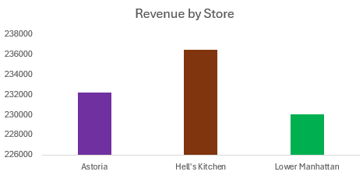
insights

Slide 6
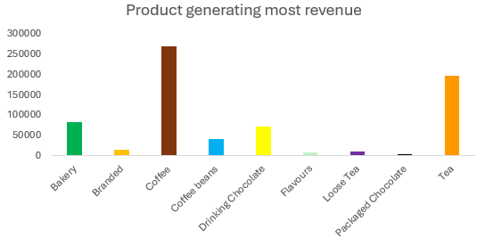
Insights

Slide 7
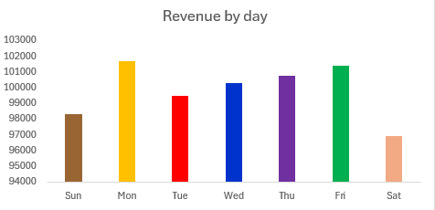
INSIGHTS

Slide 8
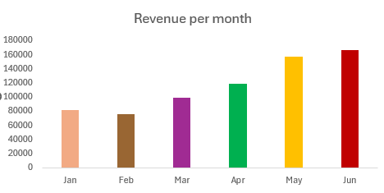
INSIGHTS

Slide 9
recommendations
Focus marketing and promotions on Saturday, which shows the lowest revenue.
Reinforce strategies on Monday and Friday, as they are peak revenue days.
Low-performing categories (e.g., Branded, Loose Tea, Packaged Chocolate) may need rebranding, bundling, or discontinuation
Lower Manhattan lags behind; investigate causes (location, customer base, product mix)

Slide 10
Question & answers

